Slide 1
Friends in Low Places
Group housing ameliorates defeat-induced deficits

Slide 3
Social Isolation Often Confounds Teen Bullying

Slide 4
Zhang et al., 2015

Slide 5
Bullying Model
Experimental animals: C57BL/6J mice
Stress Regimen
Resident-intruder protocol
Residents: CD-1 mice
10-day protocol
5-min interaction/24hr separation

Slide 6
Age Groups
Early Adolescence (EA)
Postnatal day 28-37
Late Adolescence (LA)
Postnatal day 38-47
Adult
Postnatal day 70-79

Slide 7
Zhang et al. Experimental Timeline A

Slide 8
Social Defeat and Social Avoidance: Short-Term Effects
1 day after stress exposure
# p<0.05 compared to late adolescence
** p<0.01 compared to controls
*** p<0.001 compared to controls
Notes:
Main effect of age (F(2,53) = 7.107, p=0.002) and stress (F(1,53) = 17.129, p<0.001)
Social interaction ratio of late adolescence was higher than early adolescence (p = 0.02) trending higher than adult (p = 0.072)
Social defeat induced social avoidance in all three age groups relative to controls (EA: p<0.0001; LA: p=0.0037; Adult: p=0.0013)

Slide 9
Social Defeat and Social Avoidance: Long-Term Effects
6 weeks after stress exposure
* p<0.05 compared to controls
** p<0.01 compared to controls
Adults trending p=0.052
Social stress in adolescence produces long-lasting stress effects
Notes:
Main effect of stress (F(1, 56) = 8.563, p=0.005)
No effect of age (p=0.749)
EA p<0.05
LA p<0.01

Slide 10
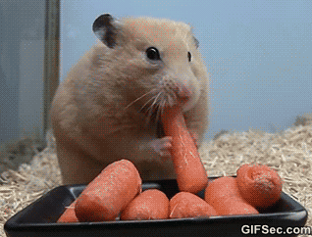
Attention Shifting Task (AST)
Day 1&2:
Training
Trained to dig food out of sawdust-filled bowls
Criteria= food retrieved in <5 min for 3 consecutive trials
(This is not a mouse. This is a hamster.)

Slide 11
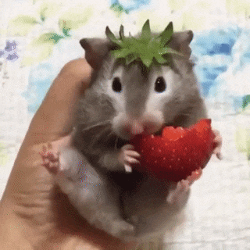
Attention Shifting Task (AST)
Day 3:
Simple Discrimination Task
Discriminate between
Different odors
Different digging media
Criteria = 6 consecutive correct trials
(Mice in this study were not given strawberries.)

Slide 12
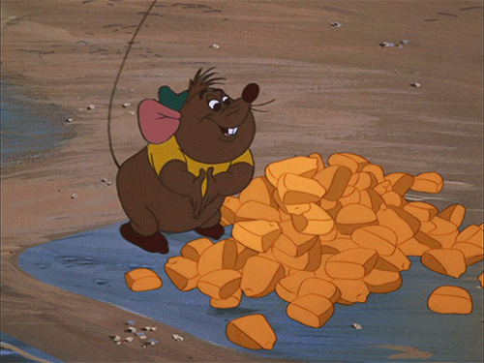
Attention Shifting Task (AST)
Day 4:
5 tasks of increasing difficulty
Simple Discrimination
Digging medium
Complex Discrimination
Digging medium + Odor
Intra-dimensional Shifting
New mediums and odors
Medium still relevant stimuli
Reversal learning
Negative medium now positive
Extra-dimensional Shifting
Odor now relevant stimuli

Slide 13
Social Defeat on AST: Short-Term
This graph is too crowded…

Slide 14
Social Defeat on AST: Short-Term
Trials to Criteria
1 Day post-defeat
* p<0.05 compared to controls
# p<0.05 compared to LA controls
Adulthood increased performance on conditional discrimination tasks
Social Defeat in adulthood decreased reversal learning

Slide 15
Social Defeat on AST: Short-Term
Errors to Criteria
6 weeks post-defeat
* p<0.05 compared to controls
# p<0.05 compared to LA controls
Adulthood increased performance on conditional discrimination tasks
Social Defeat in adulthood decreased reversal learning

Slide 16
Social Defeat on AST: Long-Term

Slide 17
Social Defeat on AST: Long-Term
Trials to Criteria
6 weeks post-defeat
* p<0.05 compared to controls
# p<0.05 compared to LA controls
Long-term deficits were only revealed after EA
No short-term deficits after EA
Reversal learning deficits
Extra-dimensional shift deficits

Slide 18
Social Defeat on AST: Long-Term
Errors to Criteria
6 weeks post-defeat
* p<0.05 compared to controls
# p<0.05 compared to LA controls
Long-term deficits were only revealed after EA
No short-term deficits after EA
Reversal learning deficits
Extra-dimensional shift deficits

Slide 19
Summary
Short-term effects
Adult controls = increased conditioned discrimination (compared to LA)
Fewer trials to reach criteria
Fewer errors before reaching criteria
Adult defeats = decreased reversal learning performance (compared to controls)
Increased trials needed to reach criteria
More errors before reaching criteria

Slide 20
Summary
Long-term effects
EA defeats (tested in adulthood)
Decreased reversal learning
Increased trials needed to reach criteria
More errors prior to reaching criteria
Decreased extra-dimensional shift learning
Increased trials needed to reach criteria
More errors prior to reaching criteria

Slide 21
What’s going on?

Slide 22
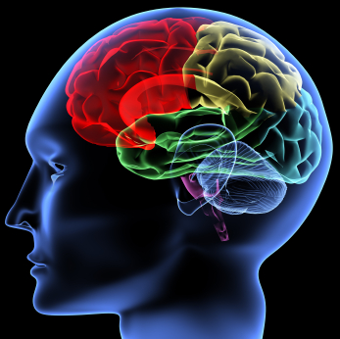
Executive Function and the Prefrontal Cortex
The prefrontal cortex (PFC) is crucial for mediating cognitive processes to permit behavioral organization and expression.
Known as executive function.
Dependent on optimal dopamine (DA) activity in the PFC.
Attention
Behavioral flexibility & inhibition
Decision making
Emotional regulation
Planning
Working memory

Slide 23
Developing Brain and the Prefrontal Cortex (PFC)
System undergoes dynamic reorganization during adolescence
PFC dopamine receptors peak in mid-adolescence
One of the last regions to develop fully
Highly vulnerable to stress-induced disruption
Gogtay et al (2004)
Weickert et al (2007)
Notes:
Maybe fill out with changes to PFC DA during adolescence? See review (ours).

Slide 24
McQuaid et al., 2013
But first, some background!

Slide 25
Effect of Defeat on Corticosterone
Social defeat increased plasma levels
Environmental enrichment (EE) increased further (in group-housed)
Social defeat + isolation increased plasma levels
No increase caused by EE

Slide 26
Effect of Defeat on PFC 5HIAA
Social defeat + isolation increased 5HIAA concentration
Environmental enrichment normalized

Slide 27
Effect of Defeat on PFC 5HT
Social defeat / isolation = no affect on 5HT concentration

Slide 28
Effect of Defeat on Hippocampus 5HIAA
Social defeat / isolation = no affect on hippocampus

Slide 29
Effect of Defeat on Hippocampus 5HT
Social defeat / isolation = no affect on hippocampus

Slide 30
Effect of Defeat on Hippocampus MHPG
Social defeat + isolation = increased hippocampus MHPG

Slide 31
Effect of Defeat on Hippocampus Norepinepherine (NE)
Social defeat / isolation = no affect on hippocampus NE

Slide 32
Summary
Effects of Social Defeat
Increased plasma corticosterone levels (regardless of housing)
Increased 5HIAA levels in hippocampus (only group housing)
Effects of Environmental enrichment
Increased plasma corticosterone levels (only in SD+group)
Normalized 5HIAA levels in PFC (only in SD +isolation)
Effects of Social Defeat + Isolation
Increased 5HIAA levels in PFC
Increased MHPG levels in hippocampus
Group Housing + Environment Enrichment possibly created a stressful environment due to limited resources.

Slide 33
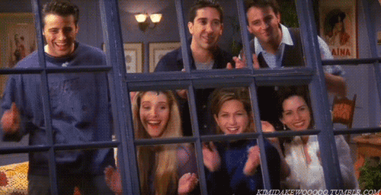
De Jong et al., 2005
The Importance of Friends

Slide 34
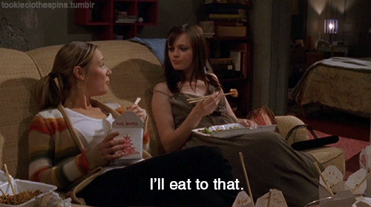
Stress and Housing on Weight Gain
Social defeat + isolation = decreased weight gain
* p<0.05
* p<0.01
* p<0.001
Group housing normalized weight gain

Slide 35
Stress and Housing on Heart Rate
Dark phase
Social defeat + isolation = decreased heart rate
Compared to control/isolation p=0.029
Compared to defeat/social (?) p=0.023
Defeat +Social = increased heart rate on day of defeat
Compared to Defeat/isolation p=0.025
Defeat + Social trending toward lower heart rate (p=0.064)
Notes:
…can you actually compare defeat/iso with cont/social? That doesn’t seem viable.

Slide 36
Stress and Housing on Heart Rate
Light phase
Control + Social = lower heart rate
Compared to control/isolation p=0.047
Compared to defeat/social p=0.014
Defeat + Social = trend toward increased heart rate
Compared to defeat/isolation p=0.076
Notes:
…can you actually compare defeat/iso with cont/social? That doesn’t seem viable.

Slide 37
Stress and Housing on Temperature
Dark Phase
Social Defeat decreased body temperature
Social Defeat + Group Housing
Compared to control p=0.027
Social Defeat + Isolation
Compared to control p=0.006

Slide 38
Stress and Housing on Temperature
Light Phase
Social Defeat + Isolation increased body temp
Compared to Controls p=0.023
Social Defeat + Group Housing increased body temp
Compared to Controls p<0.001
Compared to Defeat/isolation p=0.089

Slide 39
Stress and Housing on Locomotion
Dark Phase
Defeat + Isolation = decreased locomotion
Compared to controls p=0.011
Defeat + Group housing = no change in locomotion

Slide 40
Stress and Housing on Locomotion
Light Phase
Control + Isolation = Increased Activity
Compared to Control/Social p=0.018
Compared to Defeat/isolation p=0.024
Defeat + Group Housing = Increased Activity
Compared to Control/Social p=0.05
Compared to Defeat/isolation p=0.071

Slide 41
Stress and Housing on Hyperthermic Response
20 min response
Defeat increased hyperthermic response
Compared to control p=0.02
120 min response
Isolation increased hyperthermic response
Compared to social p=0.009

Slide 42
Summary
Effect of social defeat
Decreased body temperature in dark phase
Effect of defeat/isolation
decreased heart rate in dark phase
Increased body temperature in light phase
Decreased locomotion in dark phase
Effect of defeat/social housing
Trend toward increased heart rate in light phase
Increased body temperature (over stress and housing) in light phase
Trend toward increased activity in light phase

Slide 43
Summary
Effect of control/social housing
Decreased heart rate in light phase
Effect of Control/isolation housing
Increased locomotion in light phase

Slide 44
Zhang et al., 2015
And now back to your regularly scheduled programming!

Slide 45
Experimental Timeline B

Slide 46
Stress and Housing on Social Interactions
Social Defeat
Decreased social interaction p<0.05
Regardless of Housing Experience

Slide 47
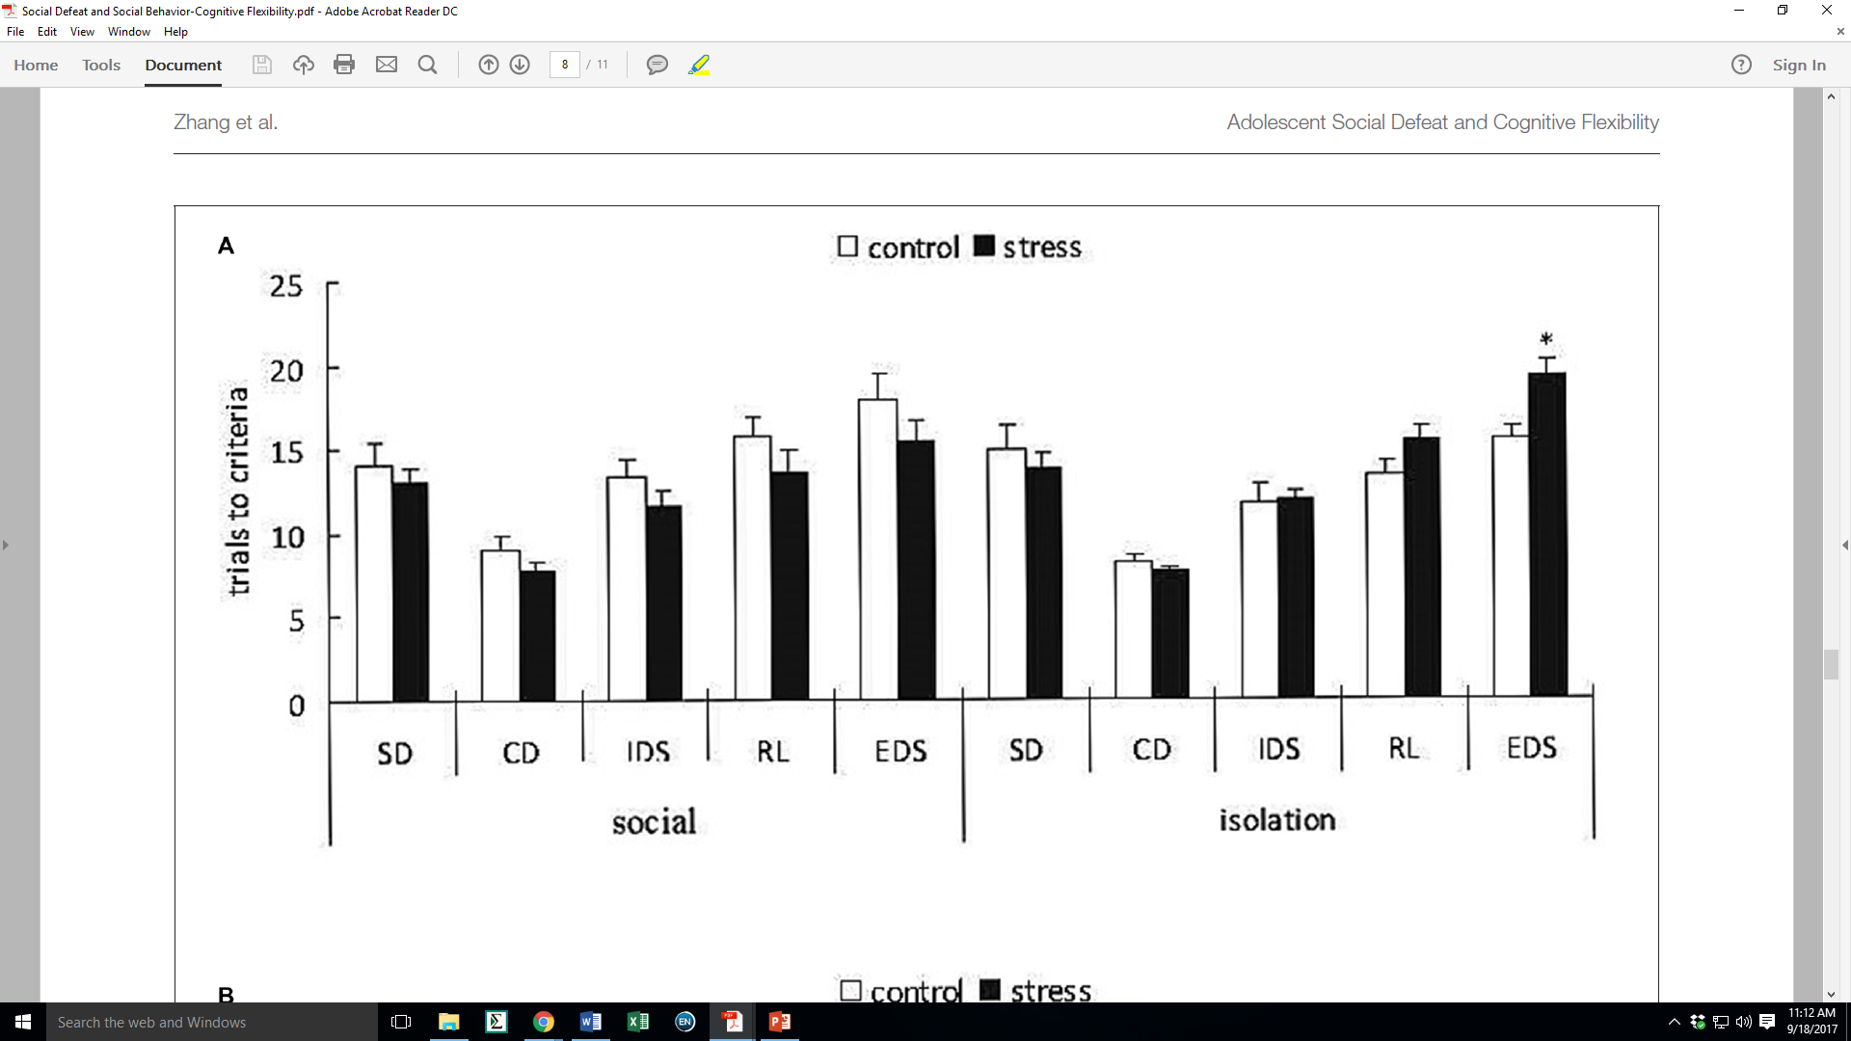
Stress and Housing on Discrimination Tasks

Slide 48
Stress and Housing on Discrimination Tasks
Trials to Criteria
Defeat + Isolation = decreased EDS performance
Compared to control/isolation p<0.05
Defeat + Social = no change in performance
S
I

Slide 49
Stress and Housing on Discrimination Tasks

Slide 50
Stress and Housing on Discrimination Tasks
Errors to Criteria
Defeat + Social = increased reversal learning performance
Compared to controls p<0.05
Defeat + Isolation = decreased EDS performance
Compared to controls p<0.05
S
I
S
I

Slide 51
Summary
Childhood social stress decreased social interaction
No effect of housing
Social stress + isolation decreased EDS performance
Increased trials to reach criteria
Increased errors before reaching criteria
Social stress + social housing increased reversal learning
Decreased errors before reaching criteria
No change in trial number
Was performance actually improved?

Slide 52
So What?

Slide 53
Social defeat in adolescence → disorders in adulthood
Implications of decreased executive function
Executive function is necessary for… well… adulting
Decreased adulting → increased stupid decisions
Stupid decisions change society
Society affects you.

Slide 55
SD-AST: Short Term (Trials)

Slide 56
SD-AST: Short Term (Errors)

Slide 57
SD-AST: Long Term (Trials)

Slide 58
SD-AST: Long Term (Errors)

Slide 59
Brown (2008)
Crews & Boettiger (2009)
Floresco & Magyar (2006)
Robbins & Arnsten (2009)
Gogtay et al (2004)
Weickert et al (2007)

